Slide 1
Genetic Algorithm
Adam Blumhagen

Slide 2

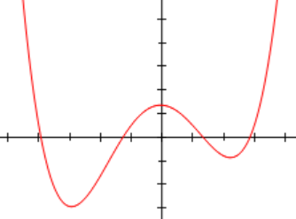
What is Optimization?
We all use optimization every day. Most likely you travel between locations minimizing the travel time/distance and not performing a random walk.
If finding the minimum of a smooth, differentiable function, you could look for where the derivative equals zero.
If you were blindfolded walking through a park, and looking for the highest point, you could sample different starting locations and walk in a random direction. If you get higher, than keep going in that direction. If getting lower, go a different direction. This would be using the gradient method. Height is an objective function in this example.

Slide 3
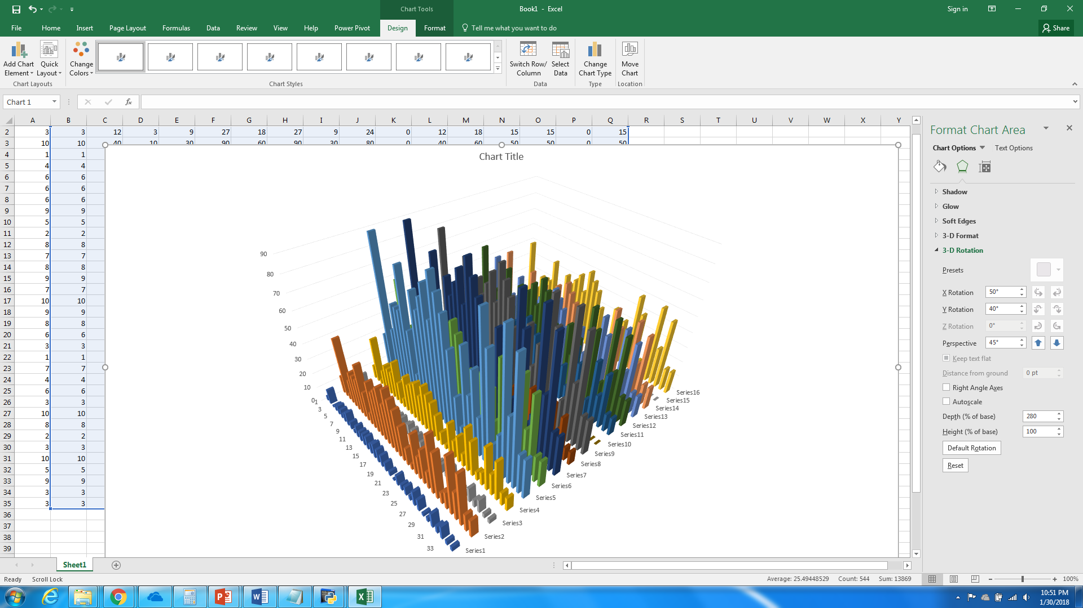
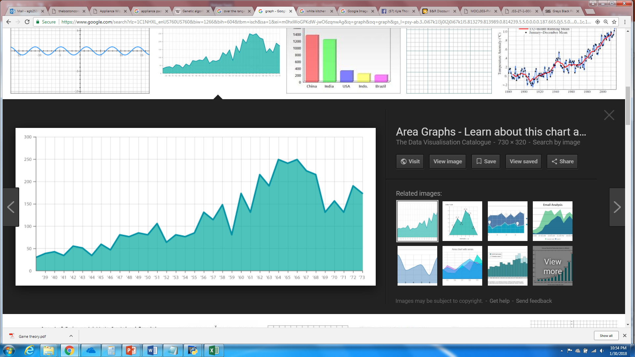
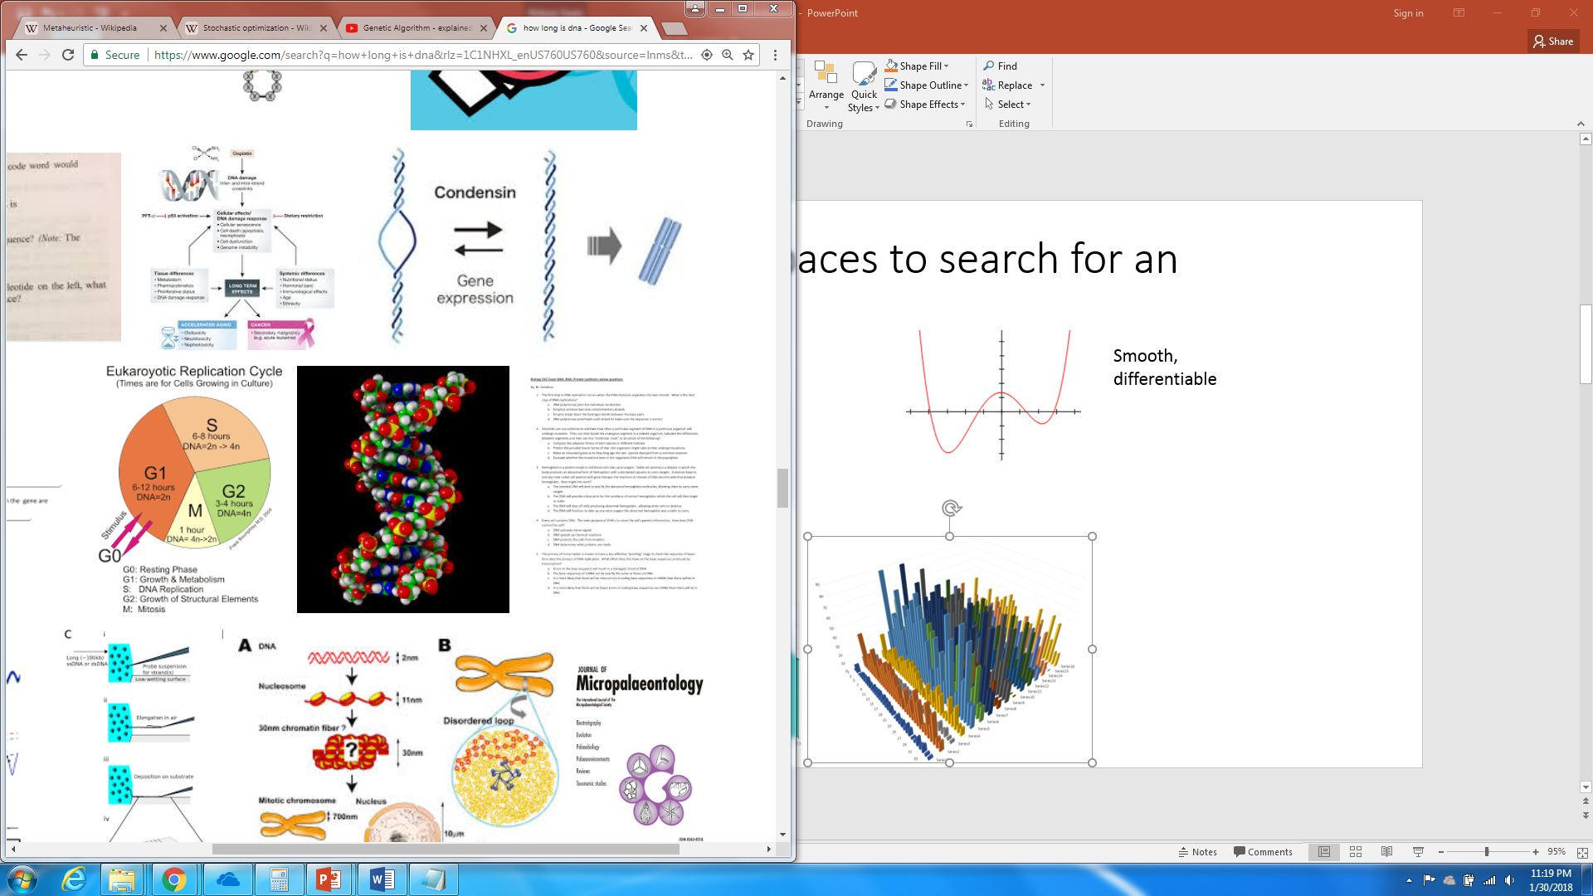
More difficult spaces to search for an optimum
Not continuous (two variables: x,y). Gradient search doesn’t work. All you can do is sample.
1 strand of human DNA has 3 billion base pairs (3 billion variables with 4 discrete base options:cytosine[C], guanine [G], adenine [A] or thymine [T] Variables interact.
Not smooth

Slide 4
Common parts of genetic algorithms
-biologically inspired: natural selection-reproduction with DNA
-stochastic: random
-metaheuristic: problem-independent technique (guess and check) that doesn’t necessarily find the exact global optimum
-combinatorial: parts from multiple chromosomes makes a new chromosome
-samples the search space

Slide 5
Genetic algorithm strategy
Create a population (one tribe or multiple tribes)
Score each member (objective function, i.e. the height in the park, each member is a chromosome)
Combine characteristics from each member to create a new member (characteristics = nucleotide). Like creating a child from parents (in genetic algorithm, you can have many parents form one child).
Repeat until a suitably optimum member is found

Slide 6
Quadratic Assignment Problem
Example: Assign each of 19 departments to another department in such a way that the total distance travelled by patients and healthcare professionals is minimized. A department cannot be assigned to more than one other department. The distance between departments, as well as the estimated flow between departments (i.e., number of time patients and healthcare professional travel between two departments) are given in the Excel file.
The QAP is NP-hard. That is, there is no known algorithm for solving this problem in polynomial time.
For more information about the QAP, see https://neos-guide.org/content/quadratic-assignment-problem

Slide 7
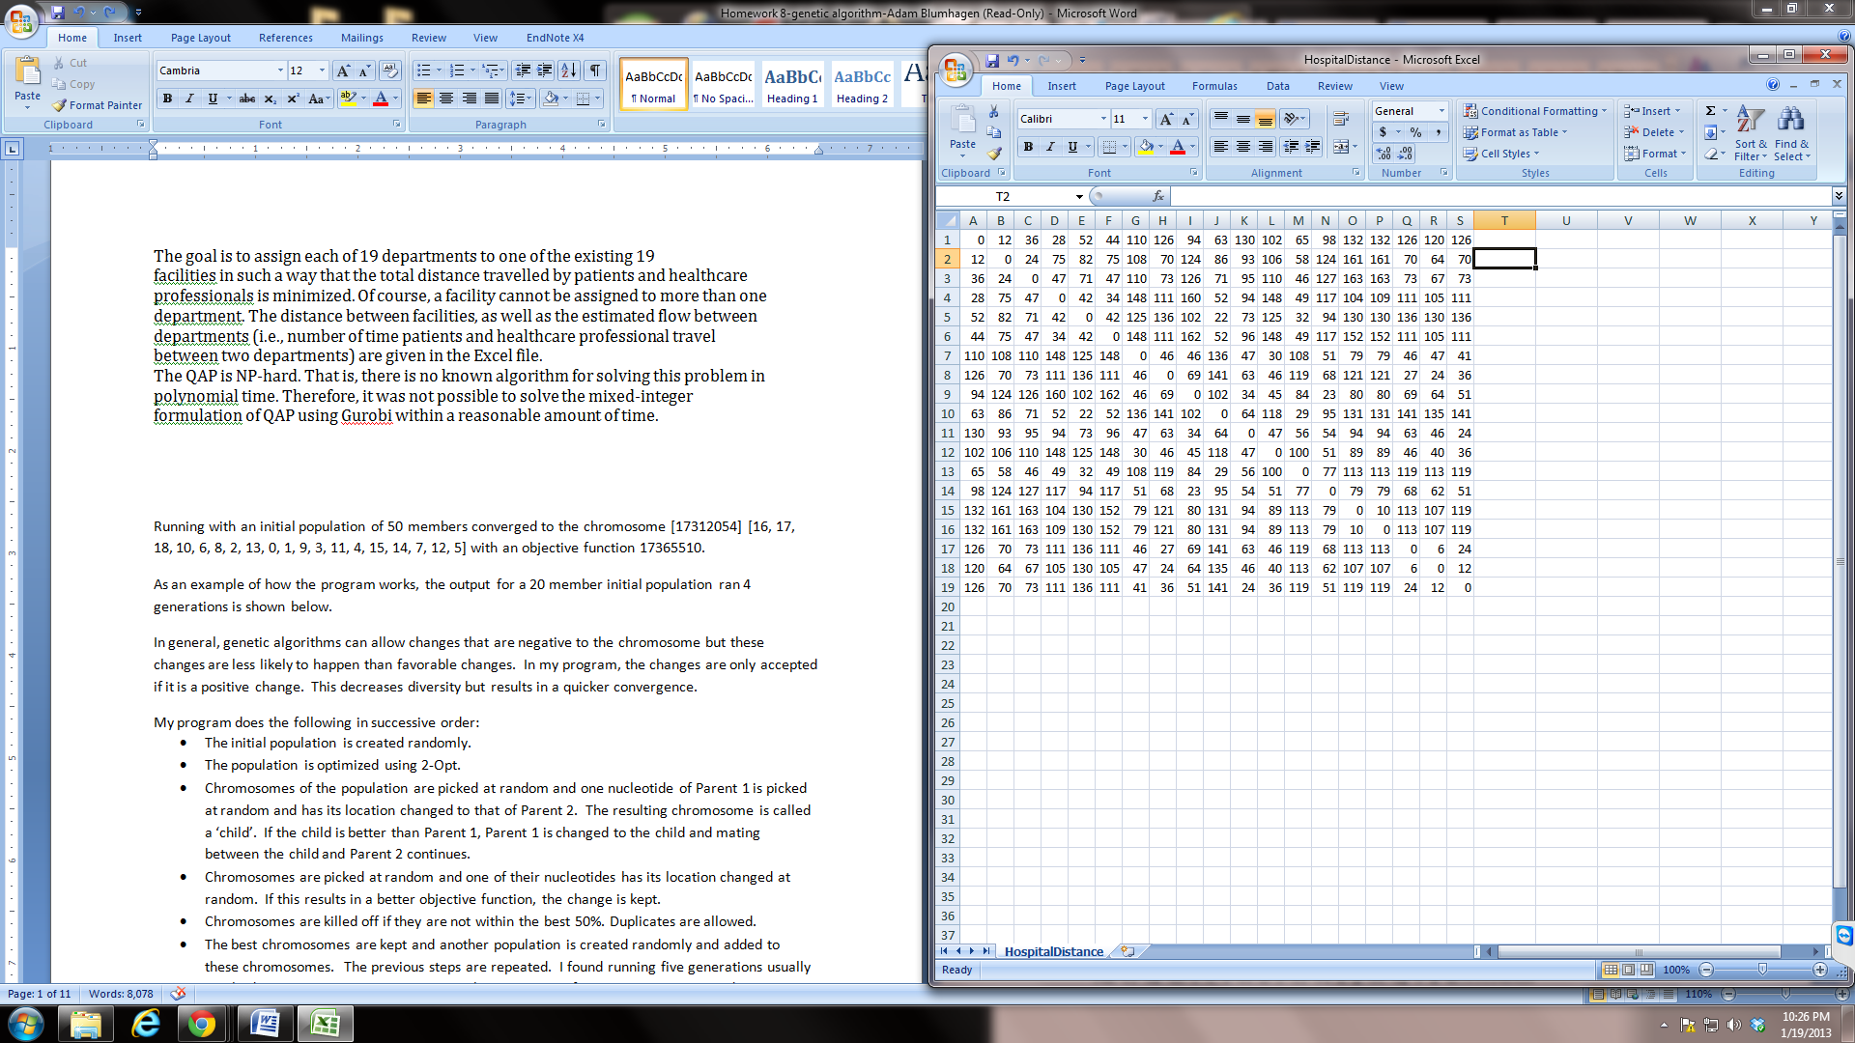
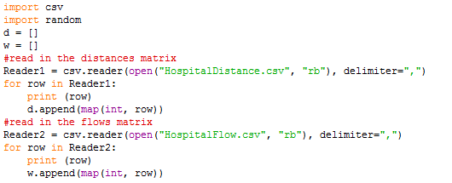
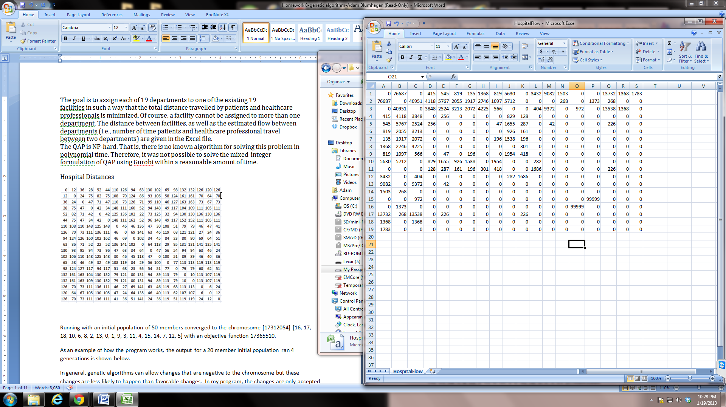
Facility Distances
Facility Flows

Slide 8
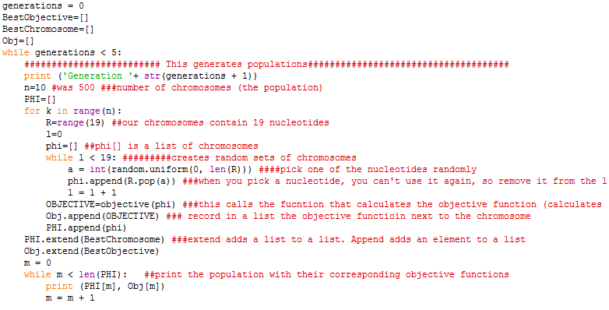
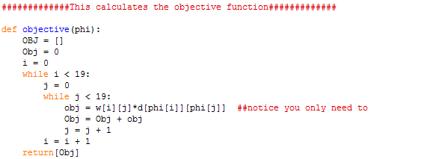

Slide 9
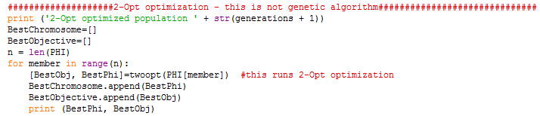
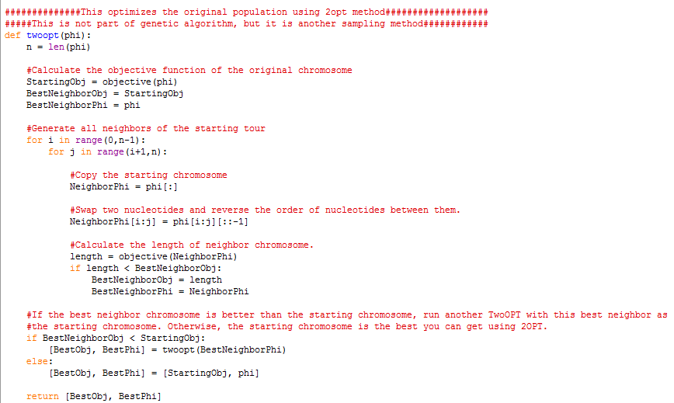
This uses the 2-opt method to optimize prior to running the genetic algorithm. This is not part of genetic algorithm strategy, so you don’t need to use it. I’m leaving it here so you can see you can use genetic algorithm in combination with other methods.

Slide 10
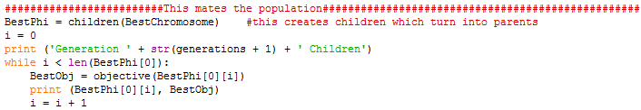
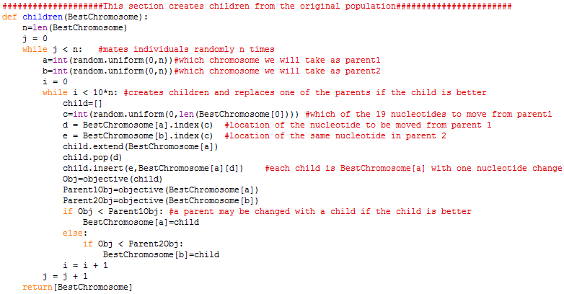

Slide 11
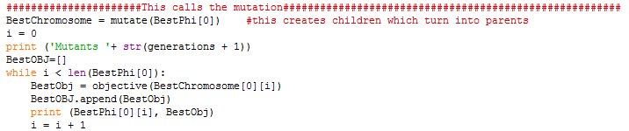
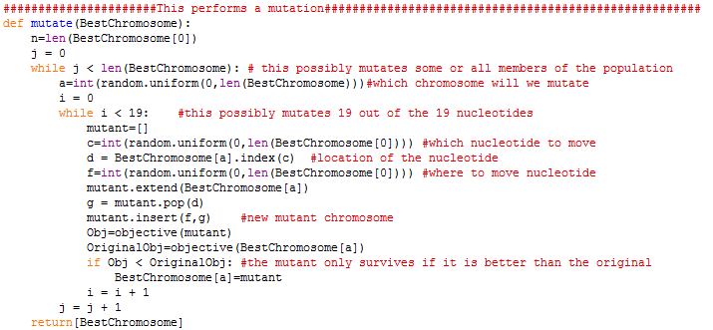

Slide 12
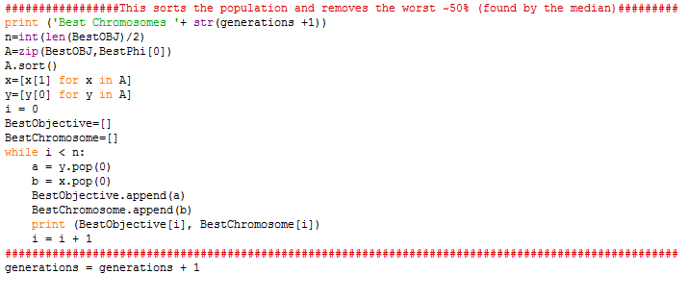
Survival of the fittest

Slide 13
My program does the following in successive order:
The initial population is created randomly.
The population is optimized using 2-Opt.
Chromosomes of the population are picked at random and one nucleotide of Parent 1 is picked at random and has its location changed to that of Parent 2. The resulting chromosome is called a ‘child’. If the child is better than Parent 1, Parent 1 is changed to the child and mating between the child and Parent 2 continues.
Chromosomes are picked at random and one of their nucleotides has its location changed at random. If this results in a better objective function, the change is kept.
Chromosomes are killed off if they are not within the best 50%. Duplicates are allowed.
The best chromosomes are kept and another population is created randomly and added to these chromosomes. The previous steps are repeated. I found running five generations usually resulted in convergence to one optimum chromosome so five generations was used.

Slide 14
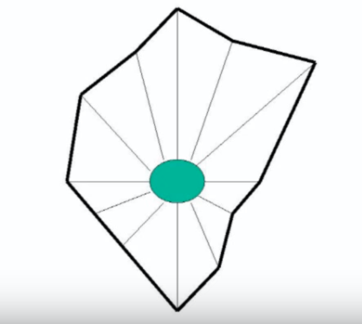

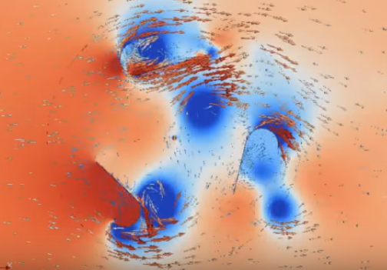
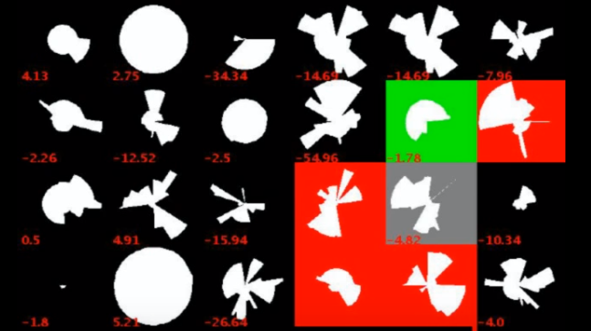
Other examples of genetic algorithm: Genetic Algorithm for wind turbine design optimization
https://www.youtube.com/watch?v=YZUNRmwoijw

Slide 15
Conclusion
Genetic algorithm is just a sampling strategy inspired by evolution
It is slow. That is why it took millions of years to arrive at humans
If calculating the objective function requires a lot of computational power/time, other strategies may be better suited (possibly in combination with genetic algorithm).

